Slide 1
Course overview
Introduction to Computers, OS and basics of Software Architecture
Versioning control - GIT
Databases – SQL
C# with DB
Scripting language basics - Javascript(JS)
Putting it all together

Slide 2
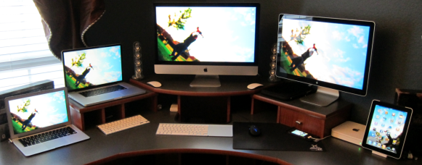
Different Computer Types
Ultrabook – Slimmer and more portable laptop
Laptop – Larger more powerful form of portable computing
Desktop – Non-portable computer
Tablet – Compact mobile computing device

Slide 3
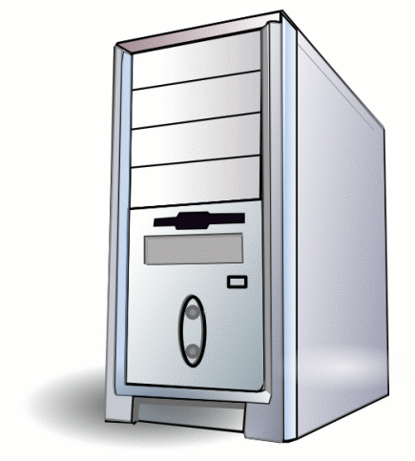
Computer Case
All-in-one Computer Case
Job – Holds all of the computer parts in the case which is mounted behind the computer display
Space saving design

Slide 4
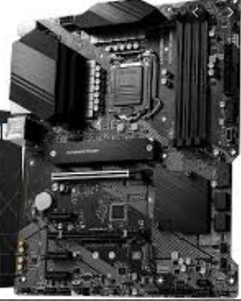
Motherboard
Job
Primary circuit board that connects all of the computer’s components
Allows the various computer components to communicate with one another
Connection point for external devices
Mouse
Keyboard
Printer

Slide 5
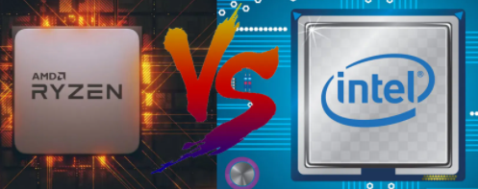
Central Processing Unit (CPU)
Job
The “brain” of the computer
Processes the instructions sent from memory and executes those instructions

Slide 6
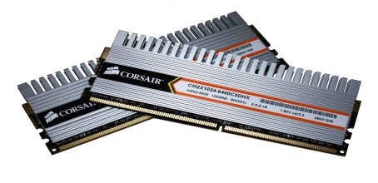
Memory
RAM – Random Access Memory
Job
Hold “active” information the computer is utilizing
Includes applications or software the computer is running
Additional memory allows the computer to operate with more applications running simultaneously
More memory often results in improved computer performance

Slide 7
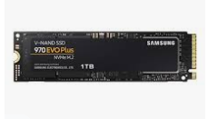
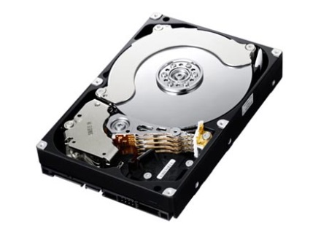
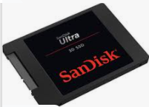
Hard Drive
Hard Disk Drive (HDD) is the computer’s long term memory
Job
Retains information when the computer is inactive or turned off including applications such as
Operating System (OS)
Programs
Data and Files
Word Documents
Pictures
Music

Slide 8
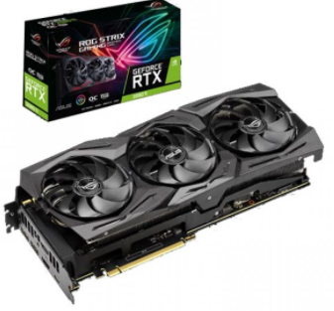
Video Card
Also known as the Graphics Card
Job
Computes and then displays all content seen on a computer screen
Is made up of several sub-components
Video Memory
Stores the data that is being used for the onscreen image
Graphics Processing Unit (GPU)
The processor that instructs what each Pixel is to display
Pixels are the thousands of dots that comprise a computer screen

Slide 9
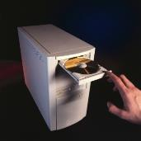
Optical Drive
Job
Read Compact Discs (CD, CD-R, CD-RW)
Read Digital Video Disc (DVD, DVR-R, DVD-RW, Blu-Ray)
Write to Discs
Referred to as a Burner
Requires –R or –RW media
Load applications, documents, and media (music, photos, and music)

Slide 10
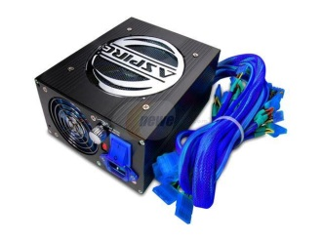
Power Supply
Job
Supplies the various components of the computer with power
Converts AC (Alternating Current) from your house’s outlet into DC (Direct Current) that the computer parts can use
Regulates and monitors the appropriate voltages and wattages to different components
Ensures computer components don’t become overloaded with power
Contains different connector types specific to the various components of the computer

Slide 11
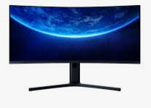
Monitor
Job
Display computer generated content
Comprised of a matrix of pixels which utilize three primary colors (Red, Green, and Blue)
Image onscreen is the output from the video card memory that has been processed by the Graphics Processing Unit
Each pixel is sent instructions on brightness, color, and when to change its state

Slide 12
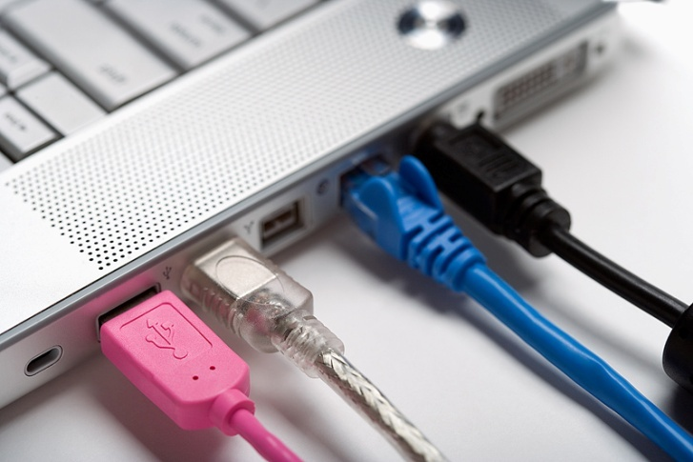
Cables
Job
Transfers data between devices
Types
USB
Firewire
Ethernet
Thunderbolt
Possible Malfunctions
Broken wire or connector at the end of the cable
Components connected won’t operate or be recognized

Slide 13
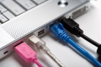
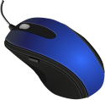
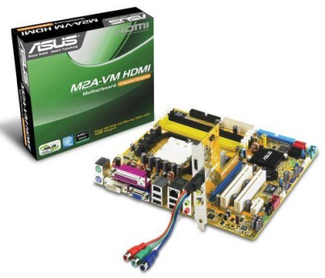
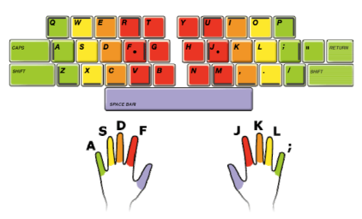
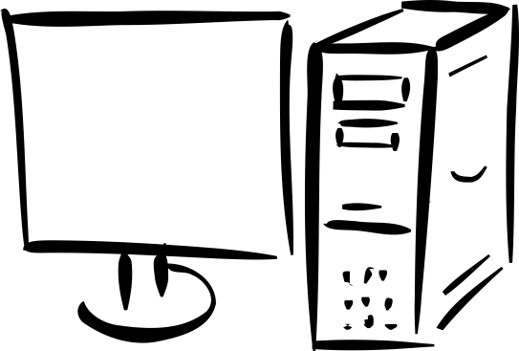
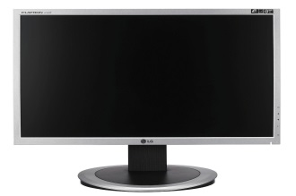
Computer Hardware
Computer hardware is the collection of physical parts of a computer system. This includes the computer case, monitor, keyboard, and mouse. It also includes all the parts inside the computer case, such as the hard disk drive, motherboard, video card, and many others. Computer hardware is what you can physically touch.

Slide 14
Possible Hardware Add-ons
Sound card (For better sound quality and editing purposes)
Networking Card (If the motherboard doesn’t have one)
Computer Cooling Fans
Speakers
Printers
Keyboards and Mice
OTHER – anything you can imagine
All of these need software

Slide 15
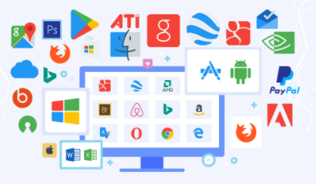
Computer Software
Computer software or simply software is any set of machine-readable instructions that directs a computer's processor to perform specific operations. Computer software is non-tangible, contrasted with computer hardware, which is the physical component of computers

Slide 16
Operating System
what an operating system is.
a brief history of operating systems.
a brief history of the Internet and the World Wide Web.
core operating system components.
goals of operating systems.
operating system architectures.

Slide 17
General information
Unprecedented growth of computing during the past several decades.
Desktop workstations execute billions of instructions per second (BIPS)
Supercomputers can execute over a trillion instructions per second
Computers are now employed in almost every aspect of life.

Slide 18
Operating System
Some years ago an operating system was defined as the software that controls the hardware.
Landscape of computer systems has evolved significantly, requiring a more complicated definition.
Applications are now designed to execute concurrently (two or more at the same time).

Slide 19
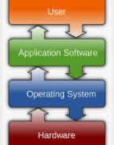
Operating System
Separates applications from the hardware they access
Software layer
Manages software and hardware to produce desired results
Operating systems primarily are resource managers
Hardware
Processors
Memory
Input/output devices
Communication devices
Software applications

Slide 20
Operating System
Operating systems evolved through several phases
1940s
Early computers did not include operating systems
1950s
Executed one job at a time
Included technologies to smooth job-to-job transitions
Programs and data submitted consecutively on tape
1960s
Process multiple jobs at once
Multiprogramming
One job could use processor while other jobs used peripheral devices
Advanced operating systems developed to service multiple interactive users

Slide 21
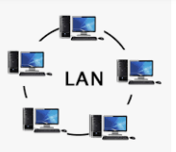
Operating System
1970s
Supported batch processing, timesharing and real-time applications
Department of Defense develops TCP/IP
Standard communications protocol
Widely used in military and university settings
Security problems
Growing volumes of information passed over vulnerable communications lines.
1980s
Decade of personal computers and workstations
Computing distributed to sites at which it was needed
Personal computers proved relatively easy to learn and use
Graphical user interfaces (GUI)
Transferring information between computers via networks became more economical and practical
Client/server computing model became widespread
Clients request various services
Servers perform requested services

Slide 22

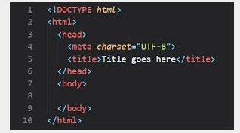
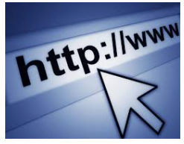
Networking starts at 80s
Advanced Research Projects Agency (ARPA) – grandpa of internet
Transmission Control Protocol/Internet Protocol
World Wide Web (WWW)
HyperText Markup Language (HTML)
Hypertext Transfer Protocol (HTTP)

Slide 23
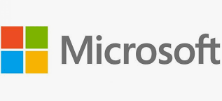

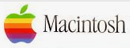
Operating System
1990
Hardware performance improved exponentially
Execute large, complex programs on personal computers.
Economical machines for extensive database and processing jobs
Shift toward distributed computing rapidly accelerated
Operating system support for networking tasks became standard
Windows operating systems lead the OS race
Object technology became popular in many areas of computing
Many applications written in object-oriented programming languages
Free and open-source software became increasingly common in the 1990s
Operating systems became increasingly user friendly
GUI features pioneered by Apple widely used and improved
“Plug-and-play” capabilities built into operating systems

Slide 24
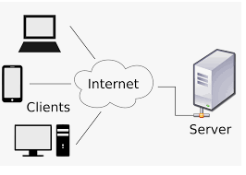
Operating System
2000s
Middleware
Links two separate applications
Often over a network and between incompatible machines
Particularly important for Web services
Simplifies communication across multiple architectures
Web services
Encompass set of related standards
Ready-to-use pieces of software on the Internet
Enable any two applications to communicate and exchange data

Slide 25
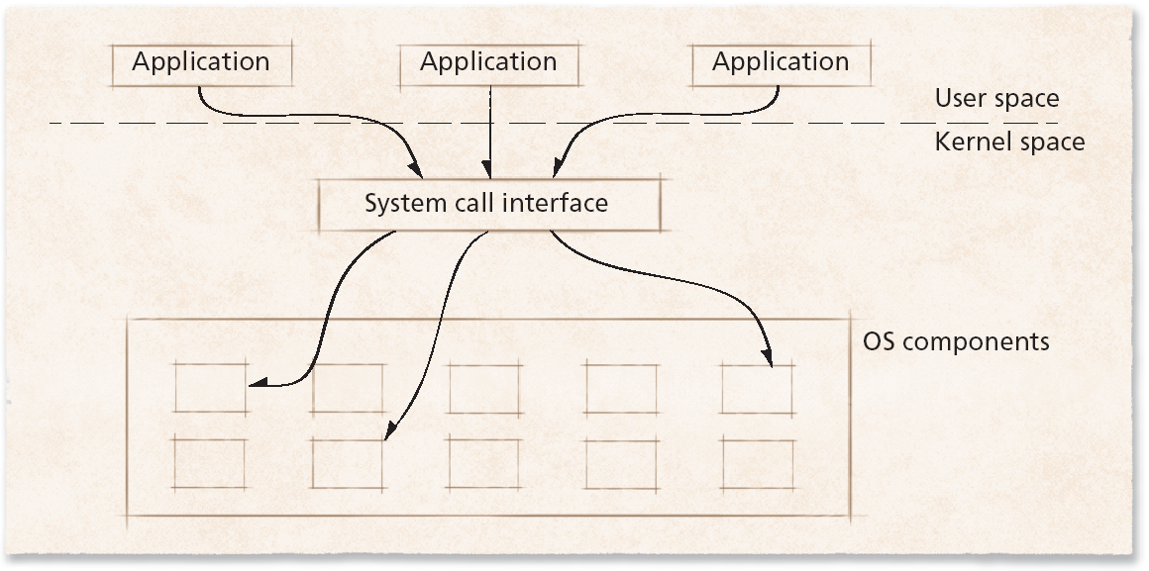
Operating System

Slide 26
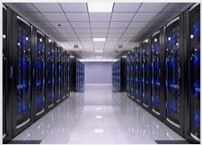
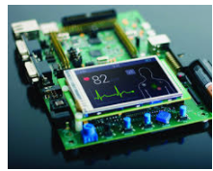
Operating System Environments
Operating systems intended for high-end environments
Special design requirements and hardware support needs
Large main memory
Special-purpose hardware
Large numbers of processes
Embedded systems
Characterized by small set of specialized resources
Provide functionality to devices such as cell phones and PDAs
Efficient resource management key to building successful operating system

Slide 27
Operating System Environments
Real-time systems
Require that tasks be performed within particular (often short) time frame
Autopilot feature of an aircraft must constantly adjust speed, altitude and direction
Such actions cannot wait indefinitely—and sometimes cannot wait at all

Slide 28
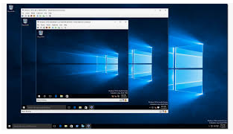
Operating System Environments
Virtual machines (VMs)
Software abstraction of a computer
Often executes on top of native operating system
Virtual machine operating system
Manages resources provided by virtual machine
Applications of virtual machines
Allow multiple instances of an operating system to execute concurrently
Emulation
Software or hardware mimics functionality of hardware or software not present in system
Promote portability

Slide 29
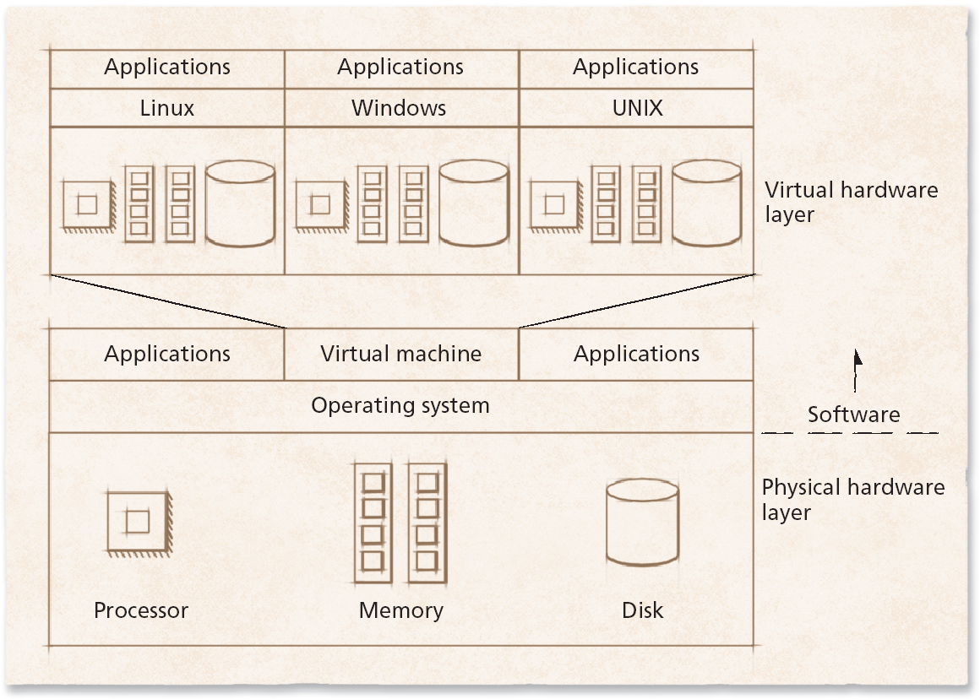
Operating System Environments – VM

Slide 30
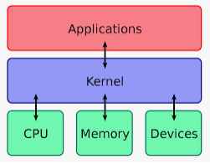
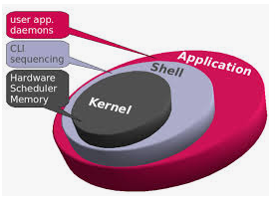
Core Operating System Components
User interaction with operating system
Often, through special application called a shell
Kernel
Software that contains core components of operating system
Typical operating system components include:
Processor scheduler
Memory manager
I/O manager
Interprocess communication (IPC) manager
File system manager

Slide 31
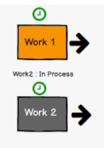
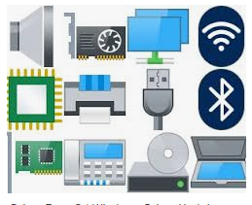
Core Operating System Components
Multiprogrammed environments now common
Kernel manages the execution of processes
Program components which execute independently but use single memory space to share data are called threads.
To access I/O device, process must issue system call
Handled by device driver
Software component that interacts directly with hardware
Often contains device-specific commands

Slide 32
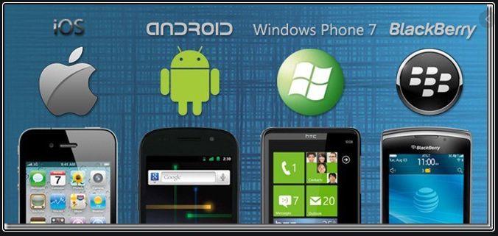
Operating System Goals
Users expect certain properties of operating systems
Efficiency
Robustness
Scalability
Extensibility
Portability
Security
Protection
Interactivity
Usability

Slide 33
Very Basic division of Software Architecture
Today’s software tend to be complex
Provide many services
Support variety of hardware and software
Software architectures help manage this complexity
Organize operating system components
Specify privilege with which each component executes

Slide 34
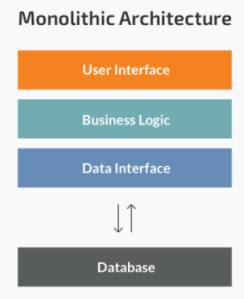
Monolithic Architecture
Monolithic system
For OS - Every component contained in kernel
Any component can directly communicate with any other
For regular software – All components in one file or one system
Tend to be highly efficient
Disadvantage is difficulty determining source of subtle errors

Slide 35
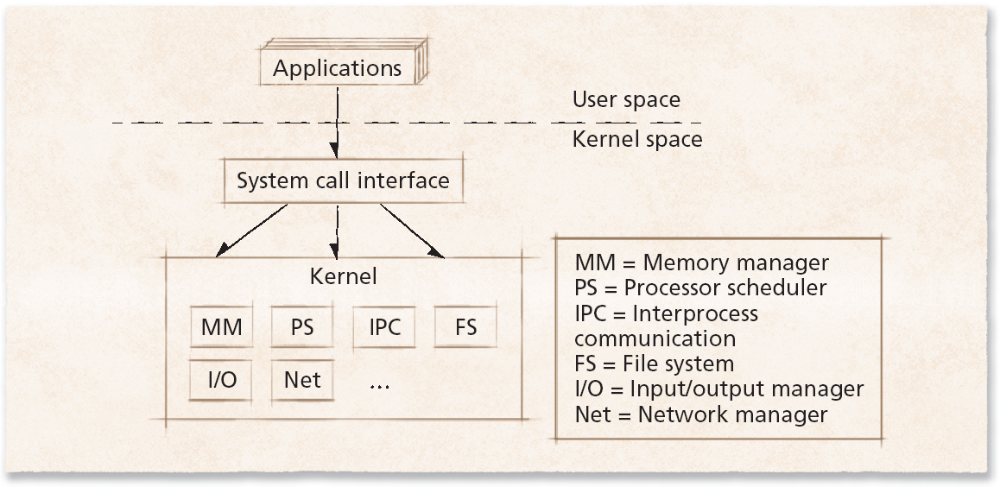
Monolithic Architecture

Slide 36
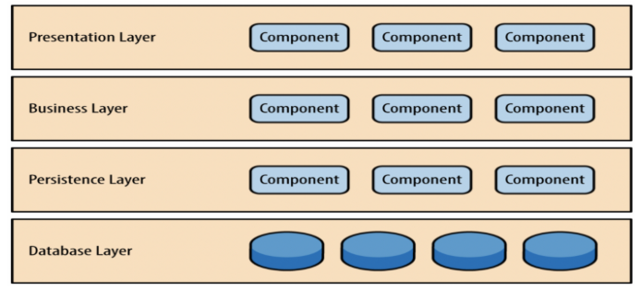
Layered Architecture
Layered approach to software
Tries to improve on monolithic designs by groups components that perform similar functions into layers
Each layer communicates only with layers immediately above and below it
Processes’ requests might pass through many layers before completion

Slide 37
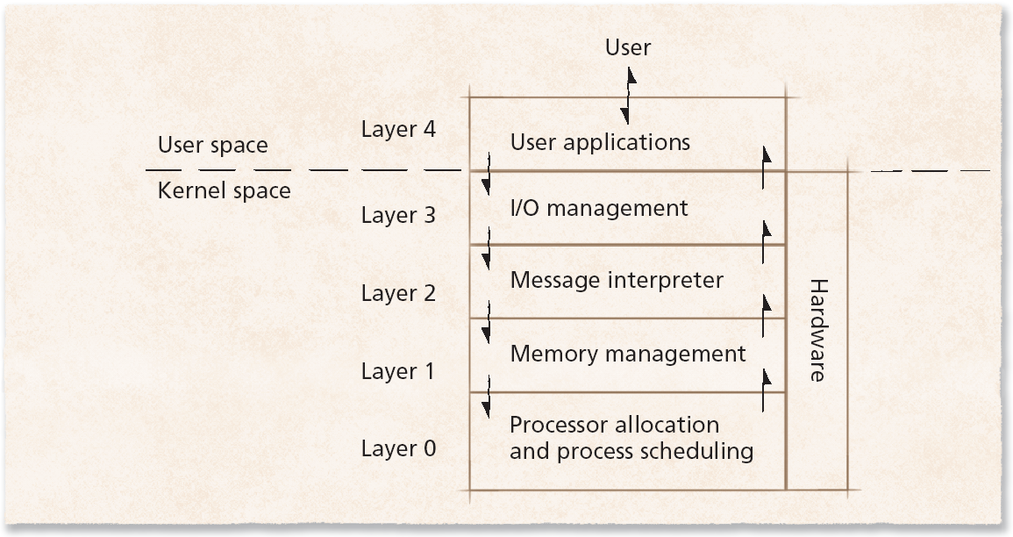
Layered Architecture

Slide 38
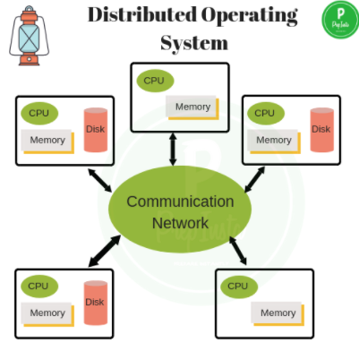
1.13.4 Networked and Distributed Software Systems
Network operating system
Runs on one computer
Allows its processes to access resources on remote computers
Distributed operating system
Single operating system
Manages resources on more than one computer system
Goals include:
Transparent performance
Scalability
Fault tolerance
Consistency

Slide 39
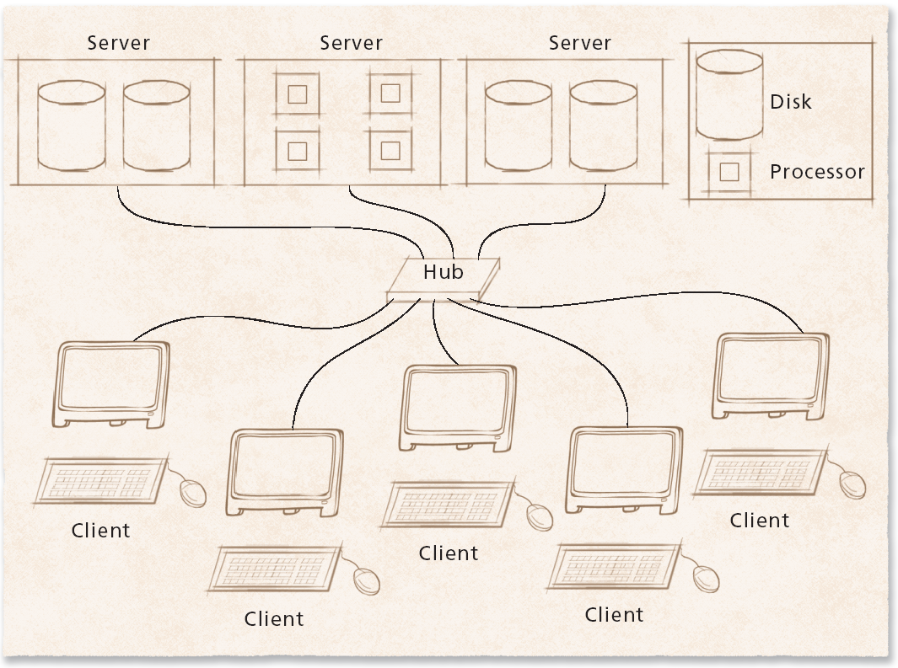
Networked and Distributed Operating Systems

Slide 40

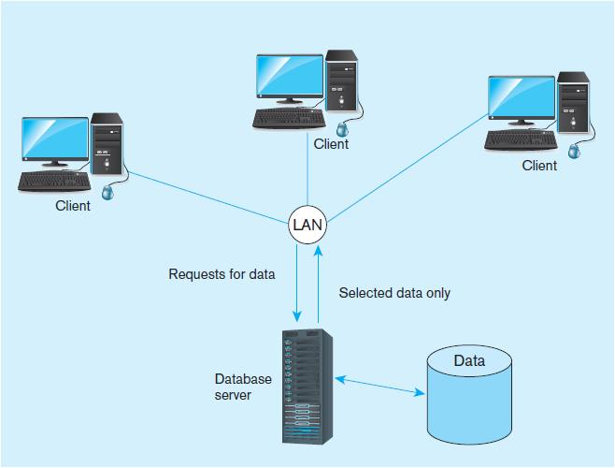
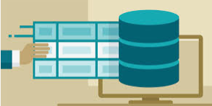
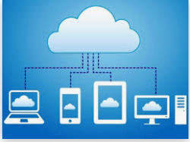
Storing and keeping data becomes complicated
Files
DB
Cloud

